Slide 1
205, Nov 18, Class 23
Final project check-in
  Post links to your procedures or printed materials
Development & Neuropsychology
  Lifespan development from infants to cognitive dysfunction in aging

Slide 2
Case Study Research Methods
Qualitative descriptions of special cases
  Observational, non-experimental
Generate theory and inspire subsequent experimental research
Illustrate and illuminate differences in human experience
  Oliver Sacks, “The Man Who Mistook His Wife for a Hat”

Slide 3
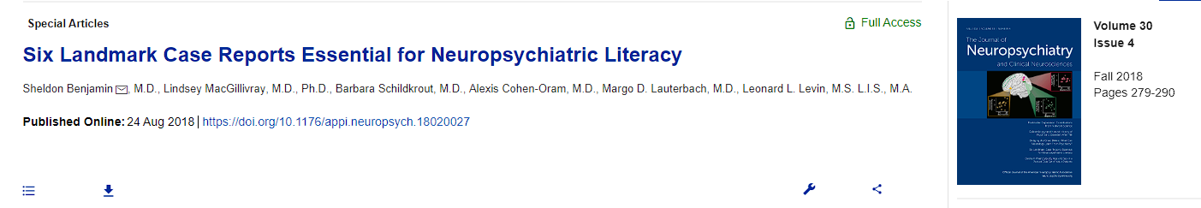
Landmark Case Studies
Phineas Gage
“Tan”
Auguste Deter
“S”
“JP”
“HM”

Slide 4
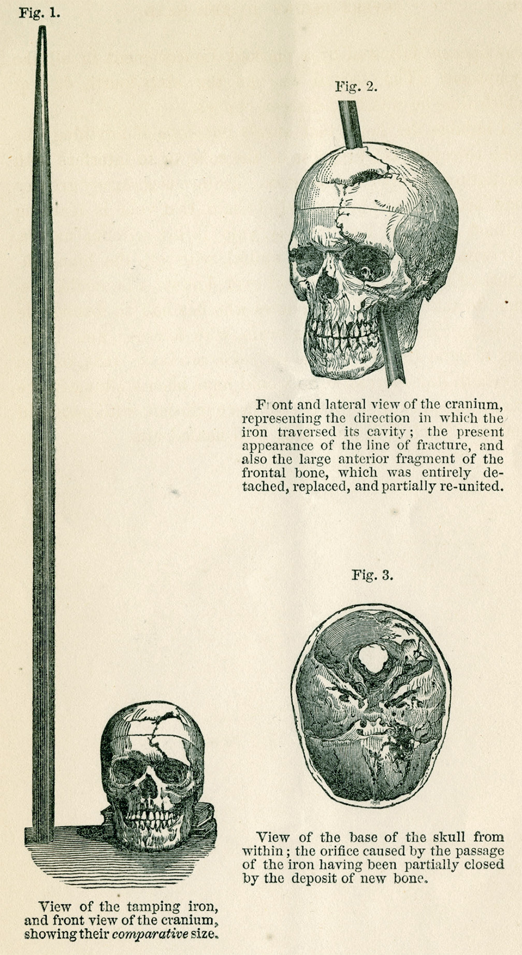
Phineas Gage
1848
Tamping iron accident
  74 days recovery
20 years later
  It was only in a follow-up paper 20 years later that Harlow described Gage’s behavioral changes after recovery. Gage had not been rehired as foreman because he had become disinhibited, with the “animal passions of a strong man,” “impatient of restraint or advice” and, “indulging at times in the grossest profanity (which was not previously his custom).”1 Having formerly been regarded as smart, efficient and capable, Gage’s friends famously stated that after the accident he was “no longer Gage.”

Slide 5
Cognitive Neuroscience
“Tan”
1861 description of an aphasic patient by Broca
Language impairment and post-mortem identification of left anterior frontal lobe damage
  Right side paralysis and language dysfunction already well-known
Localization of language as a cognitive function
  Wernicke
Modularity of cognitive operations

Slide 6
Case Studies
Auguste Deter
  First characterization of Alzheimer’s disease
Solomon Shereshevsky, “S”
  Luria’s subject in “Mind of a Mnemonist”
  Extraordinary memory, personality problems
JP
  Childhood prefrontal cortex damage and severe comportment problems
Henry Molaison, H.M.
  Characterization is the foundation of modern memory systems

Slide 7
Patient EP
Anterograde amnesia similar to HM
  Extensive bilateral medial temporal lobe damage due to encephalitis
  Extremely impaired memory
https://youtu.be/7Grh3PeEMIg?t=187

Slide 8
Developmental Research with Infants
Preferential Looking Technique
  Forced-choice preferential looking
  Violations of expectation
Core Knowledge
  Pre-wired knowledge of the world in infancy
  Sensitivity to language structure
  Awareness of visual objects, physics

Slide 9
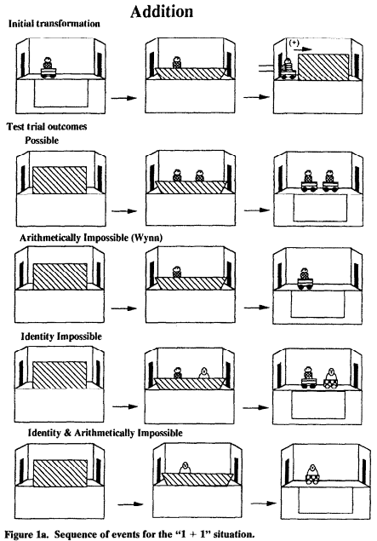
Numeracy example
Infant seated on parent’s lap facing the stage
  20 3-5m old infants (of 36)
Experimenter waited until the infant looked at the display for 5s, then the display was occluded and additional objects introduced, then scene revealed
Two independent coders analyzed video recording of infant gaze

Slide 10
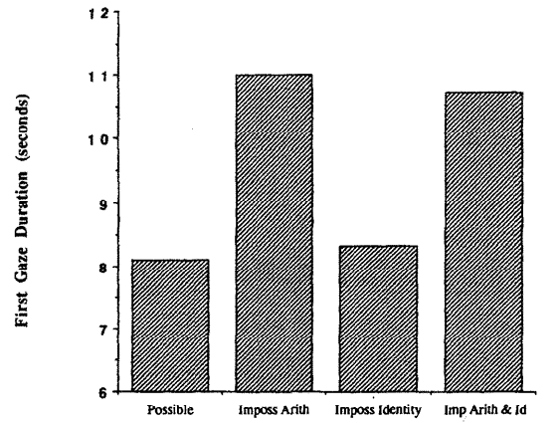
Viewing times
Babies looked longer at numerically impossible outcomes
  1 -> 2 or 2 -> 1
Did not look longer at “identity” violations
  Swapping toys
Appear to understand basic numerosity

Slide 11
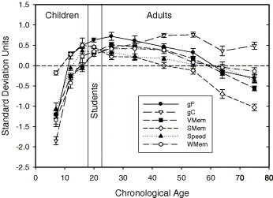
Lifespan development
Development of cognitive change
Growth in children
  Increasing to ~30
Decline in aging
  From 30-35
  General processing speed, working memory, “fluid” decreases
  Knowledge increases

Slide 12
Final project presentations
Organize like a paper
  Introduction: background and motivation for hypothesis
  Methods: specific operational definitions, DV measure, procedure
  Results: hypothesized if data not yet available
    Graph hypothetical 2x2 results showing interaction
  Discussion: what will it mean if it works
Each group member can do one section
Aim for 15 minutes of presentation

Slide 13
For Wed 3/1
Second midterm exam
Presentation schedule for next week to be posted
  Friday
  Monday

